Slide 1
CSE450
Data Mining
Week 5:
  Bayes Theorem

Slide 2

Naïve Bayes Classifier
Thomas Bayes
1702 - 1761
We will start off with a visual intuition, before looking at the math…

Slide 3

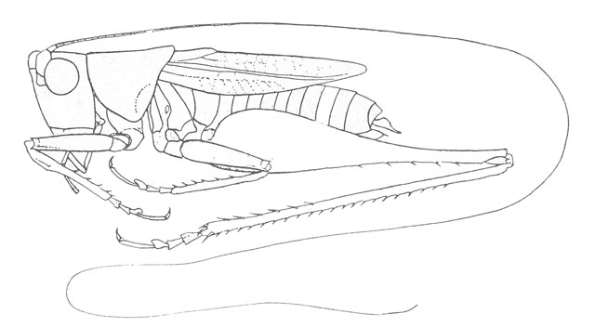
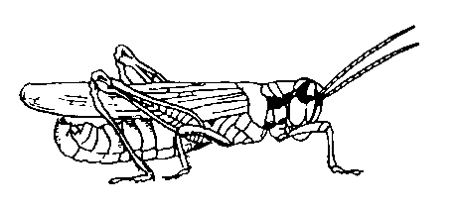
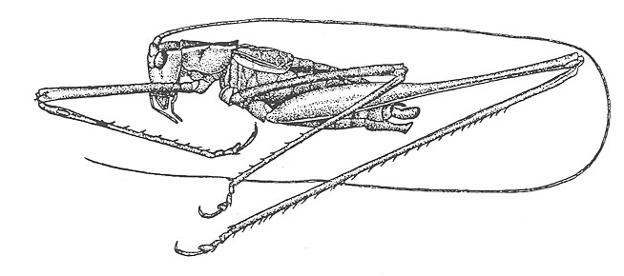
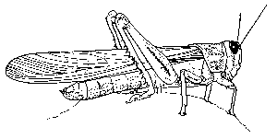
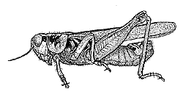
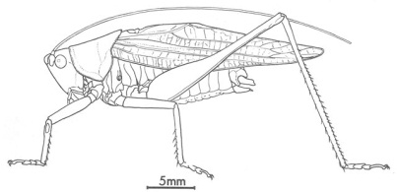
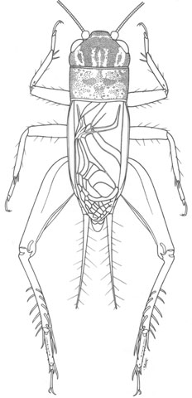
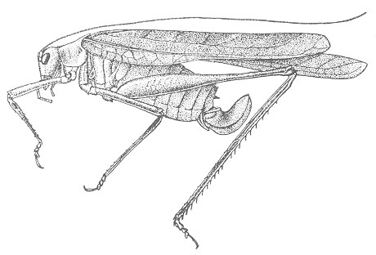
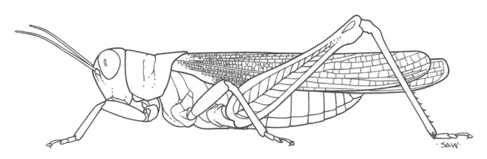
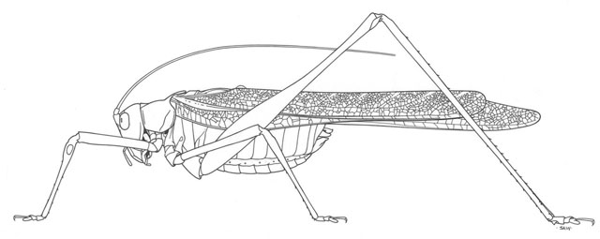
Grasshoppers
Katydids
10
9
8
7
6
Antenna Length
5
4
3
2
1
1
2
3
4
5
6
7
8
9
10
Abdomen Length
Remember this example? Let’s get lots more data…

Slide 4
With a lot of data, we can build a histogram. Let us just build one for “Antenna Length” for now…
10
9
8
7
6
Antenna Length
5
4
3
2
1
1
2
3
4
5
6
7
8
9
10
Katydids
Grasshoppers

Slide 5
We can leave the histograms as they are, or we can summarize them with two normal distributions.
Let us us two normal distributions for ease of visualization in the following slides…

Slide 6
We want to classify an insect we have found. Its antennae are 3 units long. How can we classify it?
We can just ask ourselves, give the distributions of antennae lengths we have seen, is it more probable that our insect is a Grasshopper or a Katydid.
There is a formal way to discuss the most probable classification…
p(c_{j} | d) = probability of class c_{j}, given that we have observed d
3
Antennae length is 3

Slide 7
Bayes Classifier
A probabilistic framework for classification problems
Often appropriate because the world is noisy and also some relationships are probabilistic in nature
  Is predicting who will win a baseball game probabilistic in nature?
Before getting the heart of the matter, we will go over some basic probability.
We will review the concept of reasoning with uncertainty also known as probability
  This is a fundamental building block for understanding how Bayesian classifiers work
  It’s really going to be worth it
  You may find a few of these basic probability questions on your exam
  Stop me if you have questions!!!!

Slide 8
Discrete Random Variables
A is a Boolean-valued random variable if A denotes an event, and there is some degree of uncertainty as to whether A occurs.
Examples
  A = The next patient you examine is suffering from inhalational anthrax
  A = The next patient you examine has a cough
  A = There is an active terrorist cell in your city

Slide 9
Probabilities
We write P(A) as “the fraction of possible worlds in which A is true”
We could at this point spend 2 hours on the philosophy of this.
But we won’t.

Slide 10
Visualizing A
Event space of all possible worlds
Worlds in which A is true
P(A) = Area of
reddish oval
Its area is 1
Worlds in which A is False

Slide 11
The Axioms Of Probability
0 <= P(A) <= 1
P(True) = 1
P(False) = 0
P(A or B) = P(A) + P(B) - P(A and B)
The area of A can’t get any smaller than 0
And a zero area would mean no world could ever have A true

Slide 12
Interpreting the axioms
0 <= P(A) <= 1
P(True) = 1
P(False) = 0
P(A or B) = P(A) + P(B) - P(A and B)
The area of A can’t get any bigger than 1
And an area of 1 would mean all worlds will have A true

Slide 13
Interpreting the axioms
0 <= P(A) <= 1
P(True) = 1
P(False) = 0
P(A or B) = P(A) + P(B) - P(A and B)
A
B

Slide 14
Interpreting the axioms
0 <= P(A) <= 1
P(True) = 1
P(False) = 0
P(A or B) = P(A) + P(B) - P(A and B)
A
P(A or B)
B
P(A and B)
B
Simple addition and subtraction

Slide 15
Another important theorem
0 <= P(A) <= 1, P(True) = 1, P(False) = 0
P(A or B) = P(A) + P(B) - P(A and B)
    From these we can prove:
    P(A) = P(A and B) + P(A and not B)
A
B

Slide 16
Conditional Probability
P(A|B) = Fraction of worlds in which B is true that also have A true
H = “Have a headache”
F = “Coming down with Flu”
P(H) = 1/10
P(F) = 1/40
P(H|F) = 1/2
“Headaches are rare and flu is rarer, but if you’re coming down with ‘flu there’s a 50-50 chance you’ll have a headache.”
F
H

Slide 17
Conditional Probability
P(H|F) = Fraction of flu-inflicted worlds in which you have a headache
= #worlds with flu and headache
------------------------------------
#worlds with flu
= Area of “H and F” region
------------------------------
Area of “F” region
= P(H and F)
---------------
P(F)
F
H
H = “Have a headache”
F = “Coming down with Flu”
P(H) = 1/10
P(F) = 1/40
P(H|F) = 1/2

Slide 18
Definition of Conditional Probability
P(A and B)
P(A|B) = -----------
P(B)
Corollary: The Chain Rule
P(A and B) = P(A|B) P(B)

Slide 19
Probabilistic Inference
H = “Have a headache”
F = “Coming down with Flu”
P(H) = 1/10
P(F) = 1/40
P(H|F) = 1/2
F
H
One day you wake up with a headache. You think: “Drat! 50% of flus are associated with headaches so I must have a 50-50 chance of coming down with flu”
Is this reasoning good?

Slide 20
Probabilistic Inference
H = “Have a headache”
F = “Coming down with Flu”
P(H) = 1/10
P(F) = 1/40
P(H|F) = 1/2
F
H
P(F and H) = …
P(F|H) = …

Slide 21
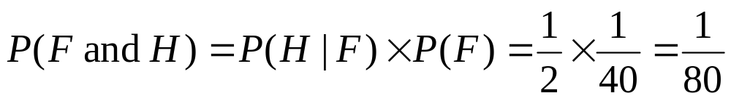
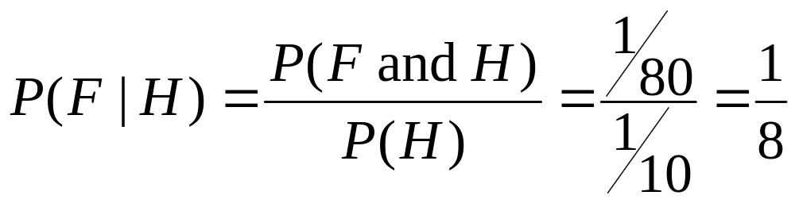
Probabilistic Inference
H = “Have a headache”
F = “Coming down with Flu”
P(H) = 1/10
P(F) = 1/40
P(H|F) = 1/2
F
H

Slide 22
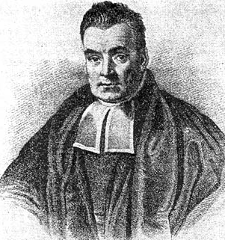
What we just did…
P(A & B) P(A|B) P(B)
P(B|A) = ----------- = ---------------
P(A) P(A)
This is Bayes Rule
Bayes, Thomas (1763) An essay towards solving a problem in the doctrine of chances. Philosophical Transactions of the Royal Society of London, 53:370-418

Slide 23
Some more terminology
The Prior Probability is the probability assuming no specific information.
  Thus we would refer to P(A) as the prior probability of even A occurring
  We would not say that P(A|C) is the prior probability of A occurring
The Posterior probability is the probability given that we know something
  We would say that P(A|C) is the posterior probability of A (given that C occurs)

Slide 24
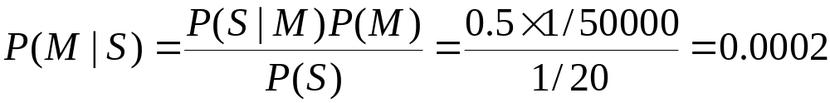
Example of Bayes Theorem
Given:
  A doctor knows that meningitis causes stiff neck 50% of the time
  Prior probability of any patient having meningitis is 1/50,000
  Prior probability of any patient having stiff neck is 1/20
If a patient has stiff neck, what’s the probability he/she has meningitis?

Slide 25
Another Example of BT
Bad Hygiene
Good Hygiene
Menu
Menu
Menu
Menu
Menu
Menu
Menu
You are a health official, deciding whether to investigate a restaurant
You lose a dollar if you get it wrong.
You win a dollar if you get it right
  Half of all restaurants have bad hygiene
  In a bad restaurant, ¾ of the menus are smudged
  In a good restaurant, 1/3 of the menus are smudged
  You are allowed to see a randomly chosen menu

Slide 26
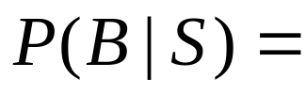
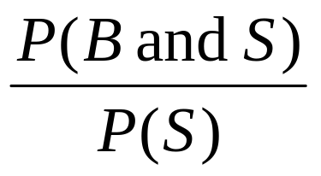
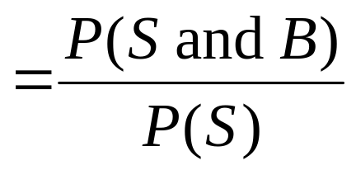
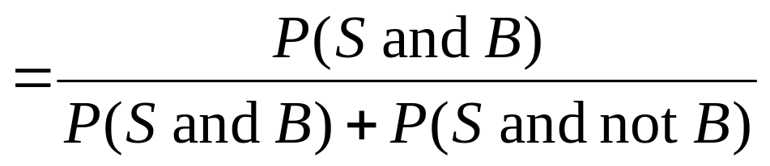
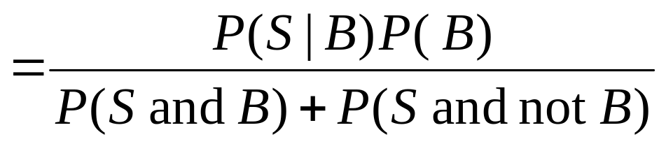
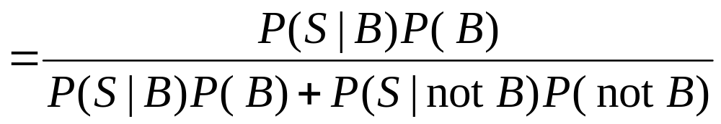
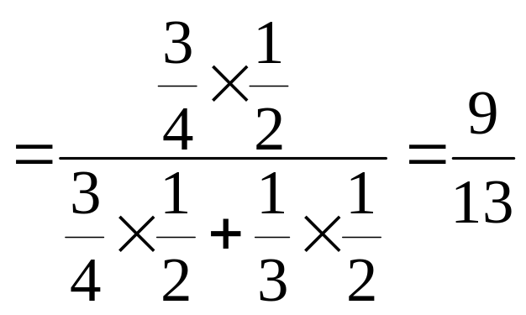

Slide 27
Menu
Menu
Menu
Menu
Menu
Menu
Menu
Menu
Menu
Menu
Menu
Menu
Menu
Menu
Menu
Menu

Slide 28
Bayesian Diagnosis
Buzzword | Meaning | In our example | Our example’s value
True State | The true state of the world, which you would like to know | Is the restaurant bad?

Slide 29
Bayesian Diagnosis
Buzzword | Meaning | In our example | Our example’s value
True State | The true state of the world, which you would like to know | Is the restaurant bad?
Prior | Prob(true state = x) | P(Bad) | 1/2

Slide 30
Bayesian Diagnosis
Buzzword | Meaning | In our example | Our example’s value
True State | The true state of the world, which you would like to know | Is the restaurant bad?
Prior | Prob(true state = x) | P(Bad) | 1/2
Evidence | Some symptom, or other thing you can observe | Smudge

Slide 31
Bayesian Diagnosis
Buzzword | Meaning | In our example | Our example’s value
True State | The true state of the world, which you would like to know | Is the restaurant bad?
Prior | Prob(true state = x) | P(Bad) | 1/2
Evidence | Some symptom, or other thing you can observe
Conditional | Probability of seeing evidence if you did know the true state | P(Smudge|Bad) | 3/4
 |  | P(Smudge|not Bad) | 1/3

Slide 32
Bayesian Diagnosis
Buzzword | Meaning | In our example | Our example’s value
True State | The true state of the world, which you would like to know | Is the restaurant bad?
Prior | Prob(true state = x) | P(Bad) | 1/2
Evidence | Some symptom, or other thing you can observe
Conditional | Probability of seeing evidence if you did know the true state | P(Smudge|Bad) | 3/4
 |  | P(Smudge|not Bad) | 1/3
Posterior | The Prob(true state = x | some evidence) | P(Bad|Smudge) | 9/13

Slide 33
Bayesian Diagnosis
Buzzword | Meaning | In our example | Our example’s value
True State | The true state of the world, which you would like to know | Is the restaurant bad?
Prior | Prob(true state = x) | P(Bad) | 1/2
Evidence | Some symptom, or other thing you can observe
Conditional | Probability of seeing evidence if you did know the true state | P(Smudge|Bad) | 3/4
 |  | P(Smudge|not Bad) | 1/3
Posterior | The Prob(true state = x | some evidence) | P(Bad|Smudge) | 9/13
Inference, Diagnosis, Bayesian Reasoning | Getting the posterior from the prior and the evidence

Slide 34
Bayesian Diagnosis
Buzzword | Meaning | In our example | Our example’s value
True State | The true state of the world, which you would like to know | Is the restaurant bad?
Prior | Prob(true state = x) | P(Bad) | 1/2
Evidence | Some symptom, or other thing you can observe
Conditional | Probability of seeing evidence if you did know the true state | P(Smudge|Bad) | 3/4
 |  | P(Smudge|not Bad) | 1/3
Posterior | The Prob(true state = x | some evidence) | P(Bad|Smudge) | 9/13
Inference, Diagnosis, Bayesian Reasoning | Getting the posterior from the prior and the evidence
Decision theory | Combining the posterior with known costs in order to decide what to do

Slide 35
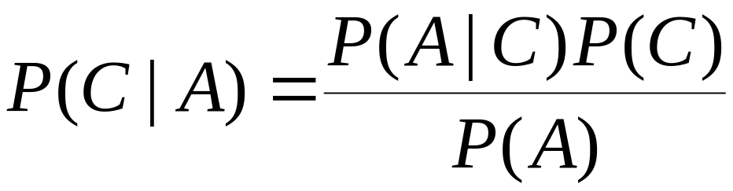
Why Bayes Theorem at all?
Why modeling P(C|A) via P(A|C)
Why not model P(C|A) directly?
P(A|C)P(C) decomposition allows us to be “sloppy”
  P(C) and P(A|C) can be trained independently

Slide 36
Crime Scene Analogy
A is a crime scene. C is a person who may have committed the crime
  P(C|A) - look at the scene - who did it?
  P(C) - who had a motive? (Profiler)
  P(A|C) - could they have done it? (CSI - transportation, access to weapons, alibi)

